Slide 1
Angular JS
Google

Slide 2
Angular JS is an open source JavaScript framework that is used to build web applications.
It can be freely used, changed and shared by anyone.
Web framework that empowers developers to build fast, reliable applications.
Maintained by a dedicated team at Google
provides a broad suite of tools, APIs, and libraries to simplify and streamline your development workflow
Angular gives you a solid platform
to build fast, reliable applications
that scale with both the size of your team and the size of your codebase

Slide 3
Prerequisites
Node.js - v^18.19.1 or newer
Text editor - We recommend Visual Studio Code
Terminal - Required for running Angular CLI commands

Slide 4
Advantages of AngularJS
Services and Dependency Injection
Two way data binding
Testing
Model View Controller
Directives, filters, modules, routes etc

Slide 5
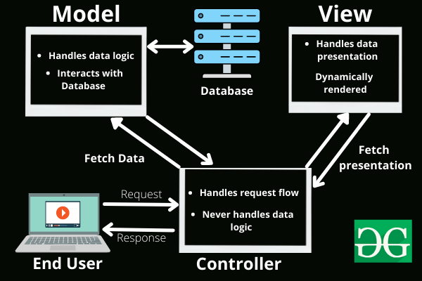
MVC Framework

Slide 6
Controller
The controller is the component that enables the interconnection between the views and the model so it acts as an intermediary.
Responsibilities:
Receiving user input and interpreting it.
Updating the Model based on user actions.
Selecting and displaying the appropriate View.
In a bookstore application, the Controller would handle actions such as searching for a book, adding a book to the cart, or checking out.

Slide 7
View
The View component is used for all the UI logic of the application
It generates a user interface for the user
Views are created by the data which is collected by the model component but these data aren’t taken directly but through the controller
It only interacts with the controller.
Responsibilities:
Rendering data to the user in a specific format.
Displaying the user interface elements.
Updating the display when the Model changes.
In a bookstore application, the View would display the list of books, book details, and provide input fields for searching or filtering books.

Slide 8
Model
The Model component corresponds to all the data-related logic that the user works with.
This can represent either the data that is being transferred between the View and Controller components or any other business logic-related data.
It can add or retrieve data from the database.
It responds to the controller’s request because the controller can’t interact with the database by itself.
The model interacts with the database and gives the required data back to the controller.
Responsibilities:
Managing data: CRUD (Create, Read, Update, Delete) operations.
Enforcing business rules.
Notifying the View and Controller of state changes.
In a bookstore application, the Model would handle data related to books, such as the book title, author, price, and stock level.

Slide 9
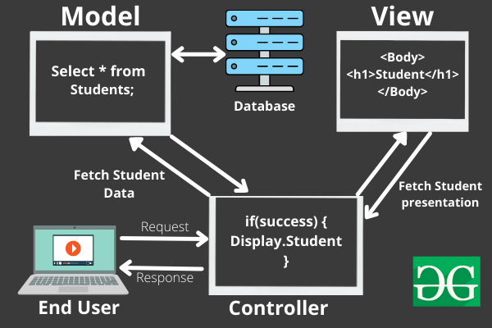
An end-user sends a request to a server to get a list of students studying in a class

Slide 10
MVC is all about
Divide and conquer
Increase cohesion
Reduce coupling
Increase reuse
Design for flexibility
Advantages
Codes are easy to maintain and extend
MVC model component can be tested separately
components of MVC can be developed simultaneously

Slide 11
Building AngularJS Applications
AngularJS is distributed as a JavaScript file, and can be added to a web page with a script tag:
<script src="https://ajax.googleapis.com/ajax/libs/angularjs/1.6.9/angular.min.js">
</script>
AngularJS extends HTML with ng-directives
The ng-app directive defines an AngularJS application
The ng-model directive binds the value of HTML controls (input, select, textarea) to application data
The ng-bind directive binds application data to the HTML view.

Slide 12
AngularJS Expressions
AngularJS binds data to HTML using Expressions.
AngularJS expressions can be written inside double braces:
{{ expression }}
AngularJS expressions can also be written inside a directive:
ng-bind="expression"
AngularJS will resolve the expression, and return the result exactly where the expression is written.
AngularJS expressions are much like JavaScript expressions: They can contain literals, operators, and variables.
Example {{ 5 + 5 }} or {{ firstName + " " + lastName }}

Slide 13
AngularJS Directives
AngularJS lets you extend HTML with new attributes called Directives
AngularJS has a set of built-in directives which offers functionality to your applications
AngularJS also lets you define your own directives
AngularJS directives are extended HTML attributes with the prefix ng-
The ng-app directive initializes an AngularJS application
The ng-init directive initializes application data
The ng-model directive binds the value of HTML controls (input, select, textarea) to application data
The ng-repeat directive repeats an HTML element
How to create your own directives?

Slide 14
AngularJS Modules and Controllers
In AngularJS, a module defines an application. It is a container for the different parts of your application like controller, services, filters, directives etc.
var app = angular.module("Module-name", []);
AngularJS controllers control the data of AngularJS applications
AngularJS controllers are regular JavaScript Objects containing attributes/properties and functions
Each controller accepts $scope as a parameter which refers to the application/module that controller is to control
The ng-controller directive defines the application controller.
app.controller(“Controller-name", function($scope) { ... } );

Slide 15
Filters
Filters can be added in AngularJS to format data.
AngularJS provides filters to transform data:
currency Format a number to a currency format.
date Format a date to a specified format.
filter Select a subset of items from an array.
json Format an object to a JSON string.
limitTo Limits an array/string, into a specified number of elements/characters.
lowercase Format a string to lower case.
number Format a number to a string.
orderBy Orders an array by an expression.
uppercase Format a string to upper case.
How to build a custom filter?

Slide 16
Services
In AngularJS you can make your own service, or use one of the many built-in services
In AngularJS, a service is a function, or object, that is available for, and limited to, your AngularJS application.
$location
$http
$timeout
$interval
etc
Create your own service:
app.service('hexafy', function() {...} );

